Slide 1
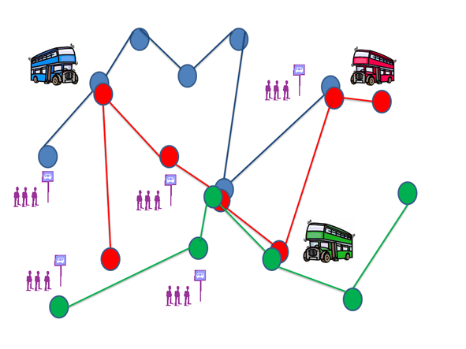

Urban Transit Routing Problem
By Nir Moshe, Rachel HaCohen, Akiva Schiff
Notes:
Make some humerous mention about how this problem haunted us the whole time – whenever travelling became a ‘thing’.

Slide 2
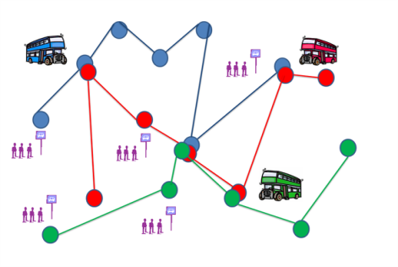

Urban Transit What?
A map of bus stations and roads connecting them
Passengers who wish to get from some stations to others
A set number of busses
The problem:
What is the optimal set of routes for the busses?
Notes:
The problem is static with time
A solution is a set of routes

Slide 3
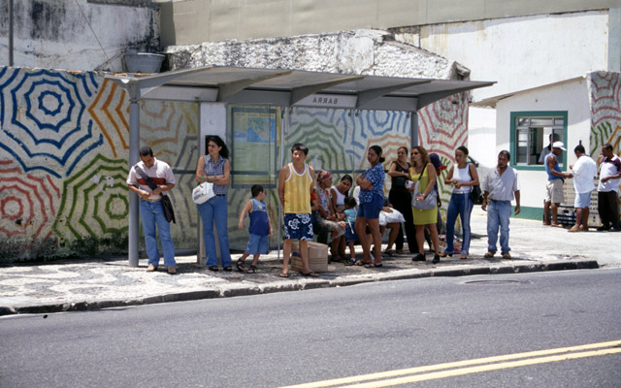
Optimal for who?
Operator cost – The sum of distance traveled by all busses
Passenger cost – The average time it takes a passenger to reach his or her destination relative to the time it could’ve taken them by direct travel (ideal value – 1.00)
Notes:
We considered two main objectives when trying to figure out how good a solution is
The passenger cost here is one we conceived of. We decided it made more sense than the one that just sums the time of the passengers since for shorter rides and longer rides we believe the same amount of time added has a different value (e.g. – 10 minutes more on a 5 minute journey is a lot more significant than a 10 minute “bonus” to a 60 minute journey).
The more interesting one here is the Passenger cost.

Slide 4
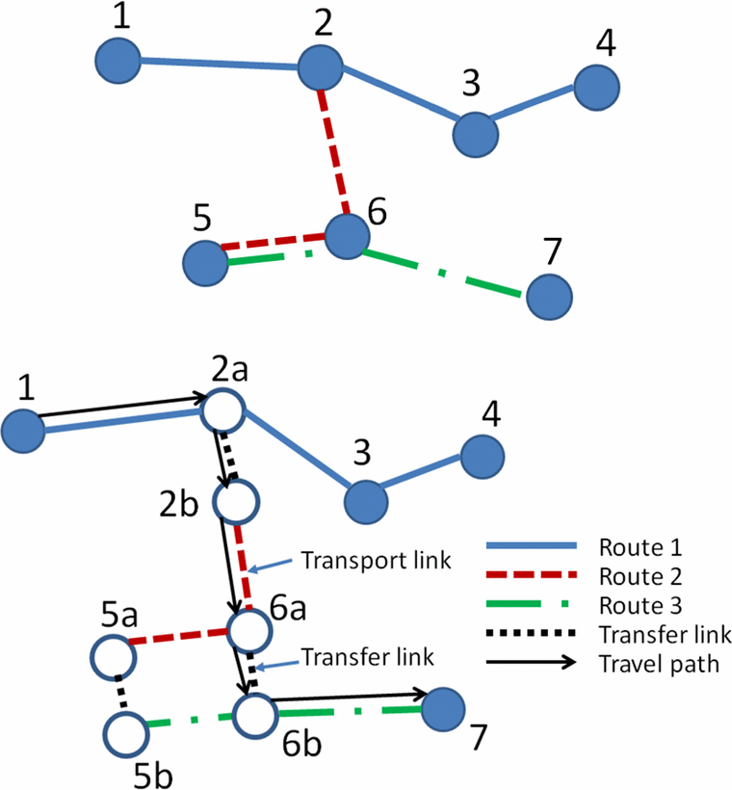
Transport vs. Transit Networks
Notes:
Explain the difference between the actual distance in the transport network and the effective distance in the transit network.

Slide 5

Optimal for who?

Slide 6
What’s so hard?
Do we really need this?
Notes:
Here we can explain why the problem actually became quite hard;
It’s a varient of VRP which is a varient of TSP which is NP.
Also, calculating passenger cost requires all pairs shortest path and this takes time. Especially since graph size grows in the transit network.

Slide 7
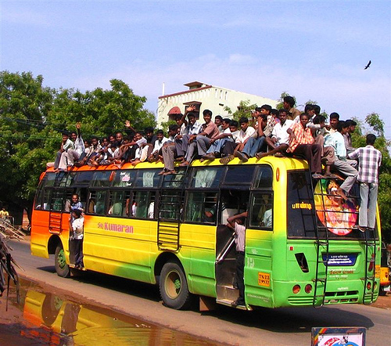
The Constraint
All passengers must be able to reach their destination
Routes must cover all stations
Connectivity between all routes

Slide 8
This is how we do it
Two approaches:
Smart construction of solutions
Constructing a route set from scratch in such a way that it will be have a superior operator or passenger cost
Genetic Algorithm
Create a population of random solutions and use a genetic algorithm with mutations to find a good solution
Notes:
Here it’s worth mentioning that unfortunately we didn’t get around to connecing the two by generation a population of already SMART solutions and then GAing them.

Slide 9
First approach – constructing a solution
Define a search space of all possible solutions and do informed search using A*.
Since we have two objective functions, the construction should be different for each one.
Therefore, separate into two problems – operator problem and passengers problem.

Slide 10

operator problem
Simpler objective function.
A* search algorithm with some heuristics found an optimal solution
For more than 2 bus lines and 7-8 stations, running time was already way too slow

Slide 11
operator problem HUB algorithm
The idea: exploit the A* advantage on bigger maps.
For N bus lines, divide the map into N-1 clusters using k-means alg.
Run A* on each cluster
Use the last bus line to connect all lines.

Slide 12
operator problem HUB algorithm
Notes:
Results were relatively good compared to run-time!

Slide 13
passengers problem
When trying to find solutions optimizing passenger objective, we found it very hard to find useful heuristics
Informed search uses very local information in order to evaluate a state while passenger objective is a much more global measure.
Notes:
Yes… We had some new insight yesterday but that was too late…

Slide 14

Genetic Algorithm
Create random, legal solutions
Create offsprings
Mutate the offsprings
Keep the better offsprings
Repeat
Notes:
Put peolple back into context – now we’re talking about generating random populations

Slide 15
Generating a solution
Randomly expand routes
Verify connectivity
Completely cover the graph
Notes:
Number 2 is done by starting every route from another one
Number 3 already requires the ‘repair’ routing

Slide 16
Repair routine

Slide 17
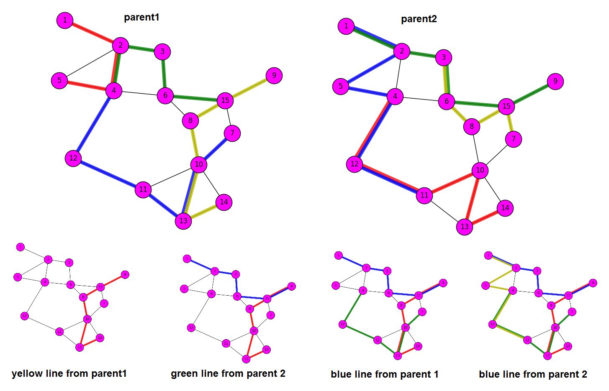
Offsprings

Slide 18
Mutations
Two types of mutations
Add – randomly grow some routes
Remove – randomly shorten some routes

Slide 19
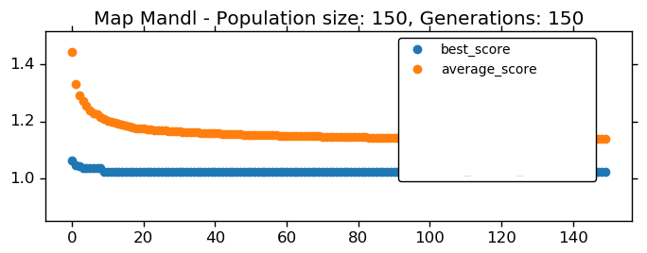
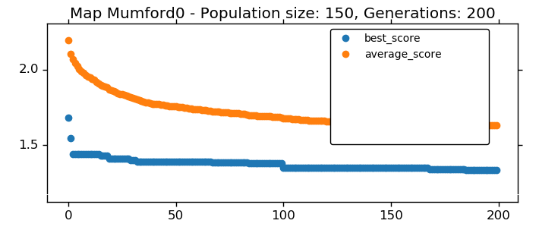
Some results

Slide 20
Limitations
Floyd-Warshall all pairs shortest path algorithm runs in V³
Graphs grow quite large with multiple busses
Notes:
Sometimes it was better to run dijakstra for when edges were less than V squared

Slide 21
Limitations
Graph of 30 nodes and 8 busses (~80 nodes in transit network), initial population of 150 solutions and 200 generations – under 5 minutes
Graph of 110 nodes and 10 busses (~280 nodes in transit network), initial population of 50 and 100 generations – 10 minutes

Slide 22
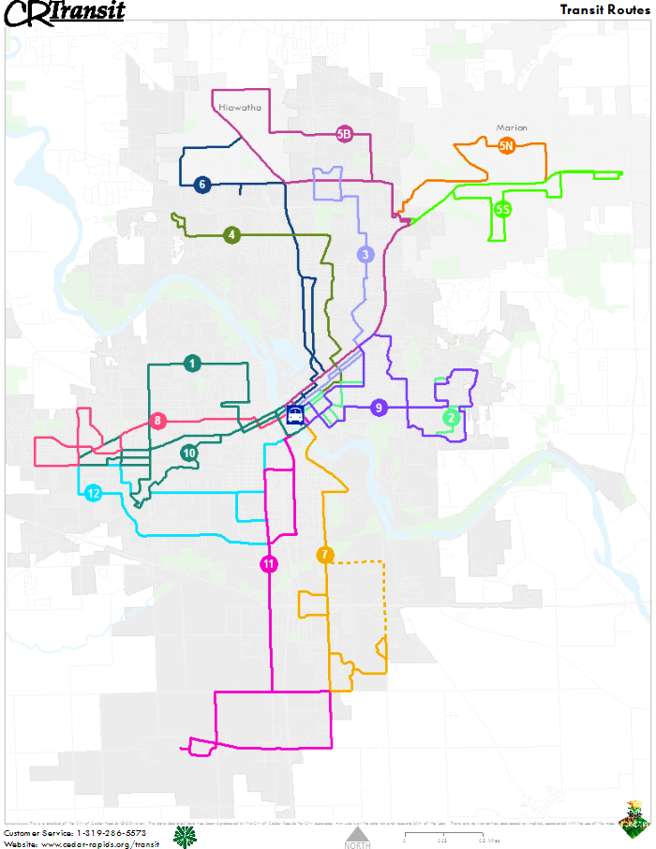
Summary
Very relevant problem
Only very recently computing speed allowed some real world solutions to be found
The problem is challenging
We want to go home
We wish we had more time

